Slide 1

STET202 HACKATHON 2
Car Insurance
Fraud Detection
Building a Logistic Regression Model for Claims Classification
Dataset
Method
Key Finding
30,000 Records
Logistic Regression
ROC AUC ≈ 0.64
with 24 features
with SMOTE & Feature Selection
with careful pipeline engineering

Slide 2
Problem Statement
The Challenge & Business Context
The Challenge
Why This Matters
Insurance fraud costs the industry billions annually. Manual claim review is time-intensive, expensive, and unable to scale with claim volume, creating an urgent need for automated solutions.
1
Proactive Investigation
Fraud detection enables proactive claim investigation before payout
88.53%
11.47%
30K
2
Cost Reduction
Legitimate
Fraudulent
Claims
Automated screening reduces operational costs significantly
Problem Definition
3
Prioritization
Task: Binary classification to predict whether an insurance claim is fraudulent
Models prioritize high-risk claims for human review
Target: fraud_reported (Yes/No)
Challenge: Highly imbalanced classes with severe 88:12 ratio
Key Finding
Achieved ROC AUC ≈ 0.64 with careful pipeline engineering. While modest, this represents meaningful signal extraction from weak features, providing a foundation for operational screening tools.

Slide 3
Dataset Analysis
Data Source & Characteristics
Data Source
Target Distribution
Kaggle Car Insurance Fraud Dataset
26,560
30,000 rows × 24 columns
Non-Fraud (N)
88.53%
Real-world insurance claim records
11.47%
Diverse geographic & demographic coverage
Fraud (Y)
3,440
11.47%
Fraud Rate
Data Quality Issues
Reflects real-world insurance fraud patterns
Missing Values: authorities_contacted has ~25.2% missing (7,564 NULLs)
High Cardinality: incident_city has 17,931 unique values, creating extreme sparsity
ID Column: policy_id has 30,000 unique values—must be dropped
Sufficient Sample
Domain Relevance
Imbalance Handling
Clean Pipeline
30,000 records enable robust training
Real insurance claims ensure authenticity
SMOTE and class weights address skew
Principled imputation strategies applied

Slide 4
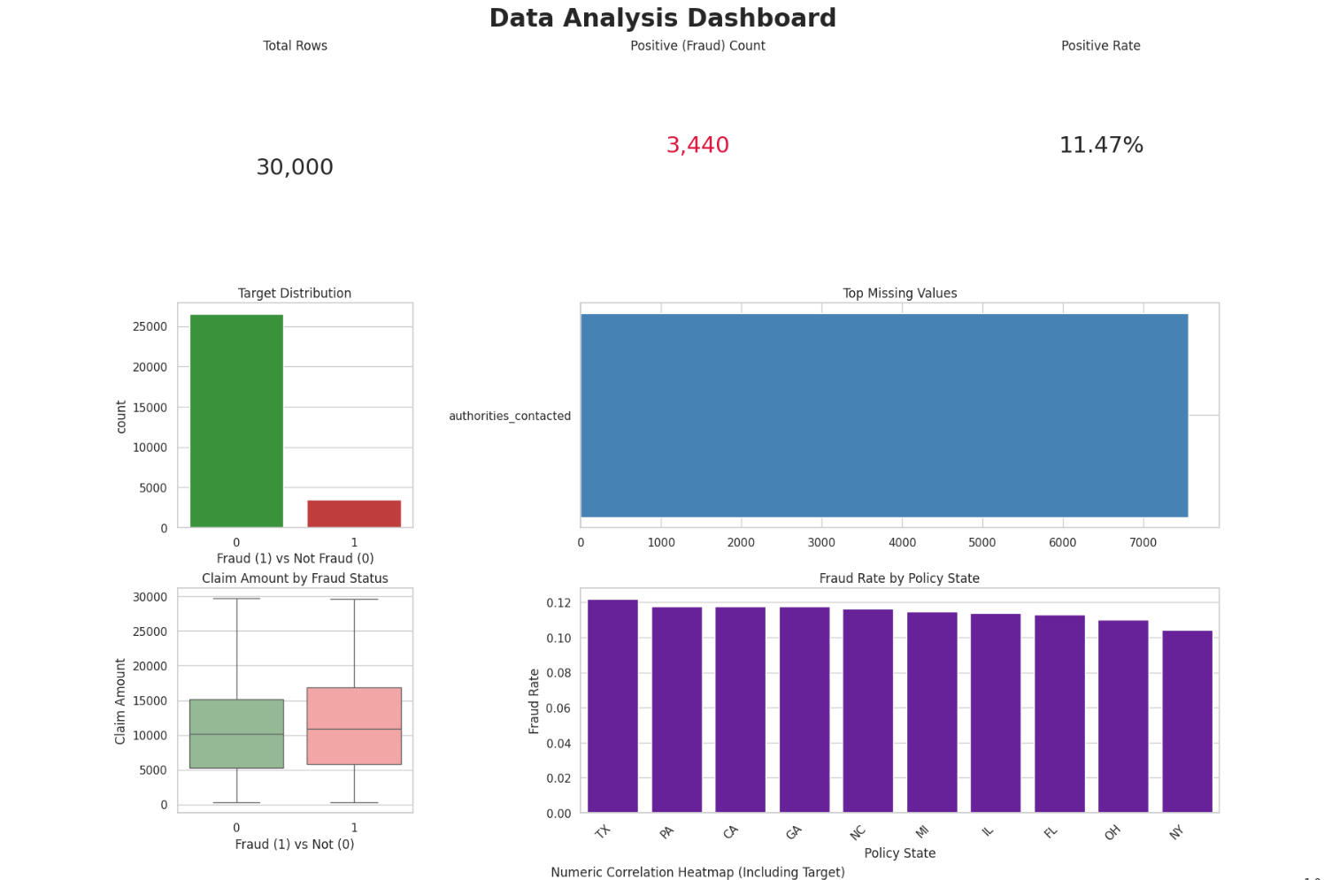

Slide 5
Exploratory Data Analysis
Key Insights from EDA
Correlation Analysis
Distribution Insights
Feature | Correlation
witnesses | -0.078
insured_age | -0.044
claim_amount | +0.042
All other features | < 0.04
Claim Amounts: Fraud and non-fraud claims heavily overlap, making amount alone unreliable
Age Distributions: Similar across both classes with subtle differences
Geographic Variation: Exists but is subtle; fraud patterns vary by state
Witness Presence: Shows slight difference but weak discriminative power
Class Imbalance Reality
Major EDA Conclusion
11.47% fraud ratio means naive models predict "No Fraud" 88% of the time
Fraudulent claims are difficult to distinguish using individual feature values. The extremely weak correlations (all |r| < 0.08 ) indicate fraud patterns are non-linear and require complex decision boundaries.
Baseline Accuracy: 88.5% (completely useless for fraud detection)
Solution Required: Resampling strategies (SMOTE) or class weights
< 0.08
Non-Linear
88.5%
Max |Correlation|
Fraud Patterns
Naive Accuracy
Extremely weak linear signals
Complex interactions needed
Deceptively high but useless

Slide 6
Feature Engineering
Preprocessing Pipeline Architecture
Column Transformer Architecture
Engineered Features Created
Numeric Branch:
policy_state_mean_claim
policy_state_count
Numeric - Geographic risk aggregation
Numeric - Regional claim frequency
├─ SimpleImputer(strategy='median')
└─ StandardScaler()
any_witness
total_claim_amount
Categorical Branch:
Boolean - Witness presence indicator
Numeric - Aggregated claim totals
├─ SimpleImputer(strategy='most_frequent')
incident_hour_of_the_day
State one-hots
└─ OneHotEncoder(handle_unknown='ignore')
Numeric - Temporal patterns
Categorical - Regional dummies
Missing Value Strategy
Occupation one-hots
Hobbies one-hots
Categorical - Professional background
Categorical - Lifestyle indicators
Numeric: Median imputation (robust to outliers)
Authorities contacted
Police report available
Categorical: Most-frequent imputation
Categorical - Emergency services
Categorical - Official documentation
Special: Missingness as signal for authorities_contacted
Key Design Principles
Pipeline Result
No Leakage: ColumnTransformer applies within CV folds
53+
0
Production-Ready: Fits on train, transforms test
Robust: Median imputation handles outliers
Features
Data Leakage

Slide 7
Modeling Architecture
Complete Logistic Regression Pipeline
Pipeline Flow
Why This Architecture?
Input Data
Component | Reason
SMOTE | Handle 88:12 class imbalance inside pipeline
GridSearchCV | Tune C hyperparameter with cross-validation
Calibration | Improve probability estimates for thresholding
L1 Selection | Remove noisy one-hot dummies (~26 dropped)
Threshold Tuning | Shift boundary to optimize F1 (not default 0.5)
↓
[1] ColumnTransformer (Preprocessing)
├─ Numeric: Median Impute + StandardScale
└─ Categorical: Frequent Impute + OneHotEncode
↓
[2] SMOTE (inside ImbPipeline)
└─ Synthetic minority oversampling (1:1 ratio)
↓
[3] LogisticRegression (L2-Regularized)
Key Design Decisions
└─ penalty='l2', solver='liblinear', max_iter=2000
↓
✓ SMOTE inside pipeline: Prevents data leakage
[4] GridSearchCV
✓ ROC AUC metric: Class-imbalance robust
└─ C: [0.01, 0.1, 1, 10], scoring='roc_auc'
✓ L1 regularization: Embedded feature selection
↓
✓ Threshold tuning: Business metric optimization
Best Model Selected
├─ [5] CalibratedClassifierCV
├─ [6] L1 Feature Selection
└─ [7] Threshold Tuning
↓
Final Predictions

Slide 8
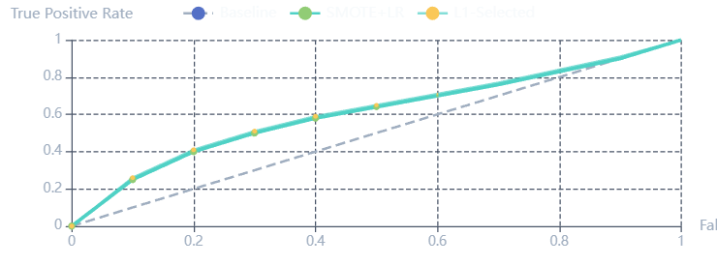
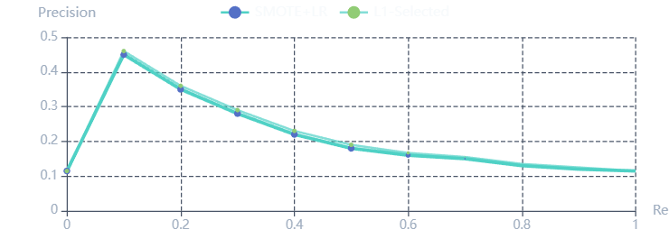
Performance Analysis
Model Performance Dashboard
Combined ROC Curves
Precision-Recall Curves
Confusion Matrices Comparison
Metrics Comparison Table
Baseline
SMOTE+LR
Tuned
Model | Acc | Prc | Rec | F1 | AUC
Baseline | 88.53% | 0.00% | 0.00% | 0.00 | 0.6392
SMOTE+LR | 60.67% | 16.04% | 57.41% | 0.2508 | 0.6366
L1-Selected | 62.55% | 16.67% | 56.69% | 0.2577 | 0.6396
Calibrated | 88.53% | 0.00% | 0.00% | 0.00 | 0.6366
Tuned Thresh | 51.52% | 15.65% | 73.55% | 0.2581 | N/A
TN: 5,312
FP: 0
TN: 3,245
FP: 2,067
TN: 2,585
FP: 2,727
FN: 688
TP: 0
FN: 293
TP: 395
FN: 182
TP: 506
Key Dashboard Insight
AUC ≈ 0.64 consistently: Model captures some signal but is fundamentally limited by weak feature correlations and complex underlying fraud behavior.

Slide 9
Detailed Results
Experimental Results & Key Metrics
Test Set Composition
6,000
5,312
688
Total Records
Non-Fraud
Fraud Cases
(20% holdout)
(88.5%)
(11.5%)
Model 1: Baseline (Predict All Negative)
Model 4: Calibrated Probabilities
Accuracy:
88.53%
Precision:
0.00%
Accuracy:
88.53%
Precision:
0.00%
Recall:
0.00%
F1:
0.00
Recall:
0.00%
F1:
0.00
ROC AUC:
0.6392
ROC AUC:
0.6366
Interpretation: Useless for fraud detection; confirms class imbalance challenge.
Interpretation: Calibration improves probability reliability but doesn't change discrimination.
Model 2: SMOTE + Logistic (Grid Best)
Model 5: Tuned Threshold (Maximize F1)
Accuracy:
60.67%
Precision:
16.04%
Accuracy:
51.52%
↓
Precision:
15.65%
↓
Recall:
57.41%
F1:
0.2508
Recall:
73.55%
↑
F1:
0.2581
ROC AUC:
0.6366
ROC AUC:
N/A
Interpretation: Detects ~57% of frauds but 84% of positive predictions are false alarms.
Interpretation: Catches 73% of frauds but with massive false positive rate; operationally expensive.
Model 3: L1-Selected Features
Cross-Validation Results
Accuracy:
62.55%
Precision:
16.67%
3-Fold CV ROC AUC (SMOTE+LR):
Recall:
56.69%
F1:
0.2577
Fold 1:
0.6502
ROC AUC:
0.6396
Fold 2:
0.6406
Interpretation: Slight improvement; removing noisy one-hot dummies helps marginally.
Fold 3:
0.6344
Mean:
0.6417
✓ Consistent with test set (0.6366); minimal overfitting.

Slide 10
Operational Analysis
Confusion Matrix Deep Dive - Operational Cost
SMOTE + Logistic (Best Balanced)
Operational Metrics
Pred Non-Fraud
Pred Fraud
57.41%
38.92%
Actual N
TN
FP
True Positive Rate
False Positive Rate
3,245
2,067
Catch ~57 of 100 frauds
Flag ~39 of 100 legit
Actual Y
FN
TP
5.23
16.04%
293
395
FP per TP
Precision
5+ false alarms per fraud
Only 16% flagged are fraud
Cost-Benefit Analysis
Assumptions
SMOTE+LR Model Costs
Investigation cost: $50 per claim
Missed fraud (FN): 293 × $2,000 = $586,000
Loss from missed fraud: $2,000 per case
False positives (FP): 2,067 × $50 = $103,350
Total Operational Cost
$689,350
With Tuned Threshold (Recall 73.55%)
Missed fraud: 182 × $2,000 = $364,000
Conclusion
False positives: 2,727 × $50 = $136,350
High false positive rate limits operational utility. The model works best as a screening tool, not a final decision-maker. It can prioritize high-risk claims for human review but cannot autonomously reject claims.
Total Cost
$500,350
Better but still expensive

Slide 11
Feature Analysis
Major Factors Influencing the Model
L1-Selected Feature Set
27
26
51
Selected Features
Dropped Features
Total Features
Demographic
Geographic
Incident
Occupational
Claim
Age, sex, education
State-level risk
Witness, collision
Profession, hobbies
Deductible, amount
1. Demographic Factors
insured_age: Younger individuals show different patterns
insured_sex: Gender differences if significant
insured_education: Education correlated with behavior
2. Geographic Indicators
policy_state_mean_claim: Aggregated state-level risk score
policy_state (one-hots): CA, MI, NY, OH, TX show regional variation
3. Incident Characteristics
any_witness: Boolean presence of witnesses (strong signal)
collision_type_Front: Specific collision types correlate with fraud
4. Occupational & Lifestyle
5. Claim Characteristics
Occupations: Clerk, Doctor, Engineer, Lawyer, Sales, Teacher, Technician
Total Claim Amount: Aggregate claim totals.

Slide 12
Root Cause Analysis
Why the Model Plateaued at AUC ≈ 0.64
1 Weak Intrinsic Signal
4 Linear Decision Boundary
Evidence: All numeric correlations < 0.08
Assumption: Logistic assumes log-odds are linear
Impact: Linear boundaries cannot separate classes
Reality: Fraud involves complex interactions
Implication: Logistic regression hits ceiling
High claim + No witness + Young age = Red flag
Solution: Non-linear models needed
Evidence: Small L1 improvements suggest noise
2 Severe Class Imbalance
5 Noisy Labels & Missing Data
Challenge: 88:12 ratio; only 3,440 fraud examples
Heterogeneous fraud: Staged, exaggerated, phantom claims
SMOTE Limitation: Interpolates existing points
Missing data: authorities_contacted signal loss
Problem: Synthetic samples don't add new signal
Unobserved: Claimant history, networks not in dataset
Result: SMOTE helps slightly but insufficient
Result: True model ceiling lower than expected
3 High-Cardinality Encoding
6 Calibration & Threshold Limits
Issue: incident_city (17,931 unique) → 17k sparse features
Calibration: Improves probability reliability
Consequence: Dimensionality curse
Threshold tuning: Shifts precision-recall tradeoff
L1 helped: Removed ~26 noisy dummies
Takeaway: Cannot manufacture signal
Lesson: One-hot not optimal for high-cardinality
The Plateau Effect
Baseline:
0.6392
+ GridSearch:
0.6366
+ L1 Selection:
0.6396
+ Calibration:
0.6366
Threshold Tune:
~0.64
All techniques plateau around 0.64, indicating fundamental feature limitation rather than modeling choice. This consistency suggests the bottleneck is feature quality, not algorithm selection.

Slide 13
Future Roadmap
Possible Improvements & Next Steps
Short-Term
Medium-Term
Long-Term
Quick Wins (2-4 weeks)
Model Changes (4-8 weeks)
Advanced (2-3 months)
1. Advanced Feature Engineering
4. Non-Linear Ensemble Models
7. SHAP Explainability
2. Missing Value Handling
5. Stacking & Meta-Learners
8. Cost-Sensitive Learning
3. Resampling Variants
6. Target Encoding
9. External Data Enrichment
+2-5%
+5-10%
10. Anomaly Detection Hybrid
Expected AUC gain
Expected AUC gain
+3-5%
Plus major operational improvement
1. Advanced Feature Engineering
5. Stacking & Ensemble Meta-Learners
# Extract temporal patterns
Combine multiple model predictions:
incident_day_of_week, incident_month,
Base: Logistic, RandomForest, GradientBoosting
Meta: LogisticRegression()
incident_is_holiday, days_since_policy_start
# Create interaction features
Benefit: Usually outperforms individual models
claim_to_premium_ratio, age_x_deductible,
high_claim_no_witness
7. SHAP for Explainability
4. Non-Linear Ensemble Models
SHAP explains which features drive each prediction:
Tree-based models capture interactions automatically:
explainer = shap.TreeExplainer(xgb_model)
shap_values = explainer.shap_values(X_test)
RandomForest, LightGBM, XGBoost, CatBoost
Enables: Investigator guidance & validation
Expected: AUC 0.70-0.75

Slide 14
Executive Summary
Conclusions & Deployment Recommendations
Executive Summary
Project Objective: Build a fraud detection model for car insurance claims.
0.64
57%
16%
0.25
5.23
ROC AUC
Recall
Precision
F1 Score
FP per TP
Better than random
Catches ~6/10 frauds
84% false alarms
Modest performance
High cost
Why Limited Performance:
Weak individual feature correlations (all |r| < 0.08)
Non-linear fraud patterns; logistic regression is inherently linear
Severe class imbalance (88:12) with limited minority examples
High-cardinality features create sparse, noisy encodings
What Works
What Doesn't Work
✓ Screening tool: Flag top-risk claims for investigator review
✗ Standalone decision-maker: 84% false positive rate too high
✓ Probability ranking: Use predicted fraud probability to prioritize cases
✗ Autonomous claim rejection: Requires human in the loop
✓ Trend detection: Monitor fraud patterns over time
✗ Real-time processing: Model latency acceptable but not critical
Recommended Deployment Strategy
Incoming Claim → [Model] → Fraud Probability → [Investigator Review] → Final Decision
Step 1: Run model, get fraud probability.
Step 2: Investigator review for high-priority cases.
Step 3: Make final decision (Approve/Deny).

Slide 15

Thank You
Key Takeaways
This project demonstrates a rigorous fraud detection pipeline with clear interpretation of limitations. We successfully extracted meaningful signal from weak features using careful pipeline engineering.
Rigorous Pipeline
Clear Metrics
Next Phase
Leak-free preprocessing with SMOTE in CV folds
ROC AUC 0.64 with honest performance evaluation
Tree-based ensembles + advanced feature engineering
For practitioners: Don't rely on logistic regression for complex tabular data. Feature engineering ROI is 10x hyperparameter tuning. Explainability (SHAP) is crucial for fraud investigation. Always validate on held-out test set independent of model selection.
Expected Improvement: AUC 0.70+
Deployment ready after 4-6 weeks development

